Slide 1
Trigonometry Tidbits
Teacher Quality Workshop
2/16/2017

Slide 2
Euler’s Formula

Slide 3
Euler’s Neat Formula

Slide 4
Equality of Complex Numbers
Complex numbers w and z are equal if and only if
Re(w) = Re(z) and
Im(w) = Im(z).
-----------------------------------------------------------
a + i b = c + i d ↔ a = c and b = d

Slide 5
Euler’s Formula Unlocks Trig Identities
Expand (e^{iθ})² two different ways
First use law of exponents, then apply Euler’s Formula
First use Euler’s Formula, then multiply out

Slide 6
Expand (e^{iθ})²
First use law of exponents, then apply Euler’s Formula

Slide 7
Expand (e^{iθ})²
First use Euler’s Formula, then multiply out

Slide 8
Set the two expansions of equal (e^{iθ})² equal
Replace 2θ with a:

Slide 9
Euler’s Formula Unlocks Trig Identities
Expand (e^{iA}) (e^{iB}) two different ways
First use law of exponents, then apply Euler’s Formula
First use Euler’s Formula, then multiply out

Slide 10
Expand (e^{iA}) (e^{iB})
First use law of exponents, then apply Euler’s Formula

Slide 11
Expand (e^{iA}) (e^{iB})
First use Euler’s Formula, then multiply out

Slide 12
Set the two expansions of equal (e^{iA}) (e^{iB}) equal
Replace B with –B, use even/odd properties:

Slide 13
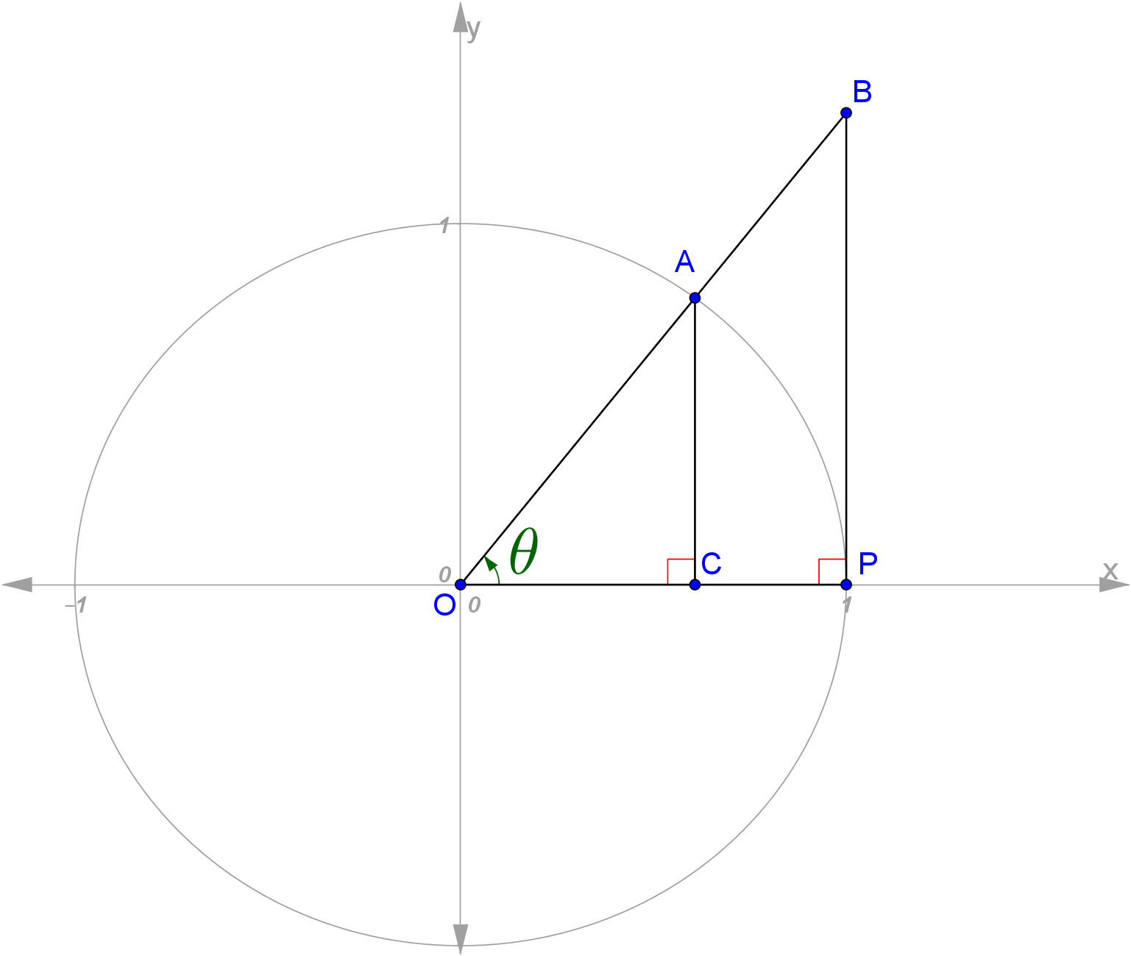
How were the trig functions named?

Slide 14
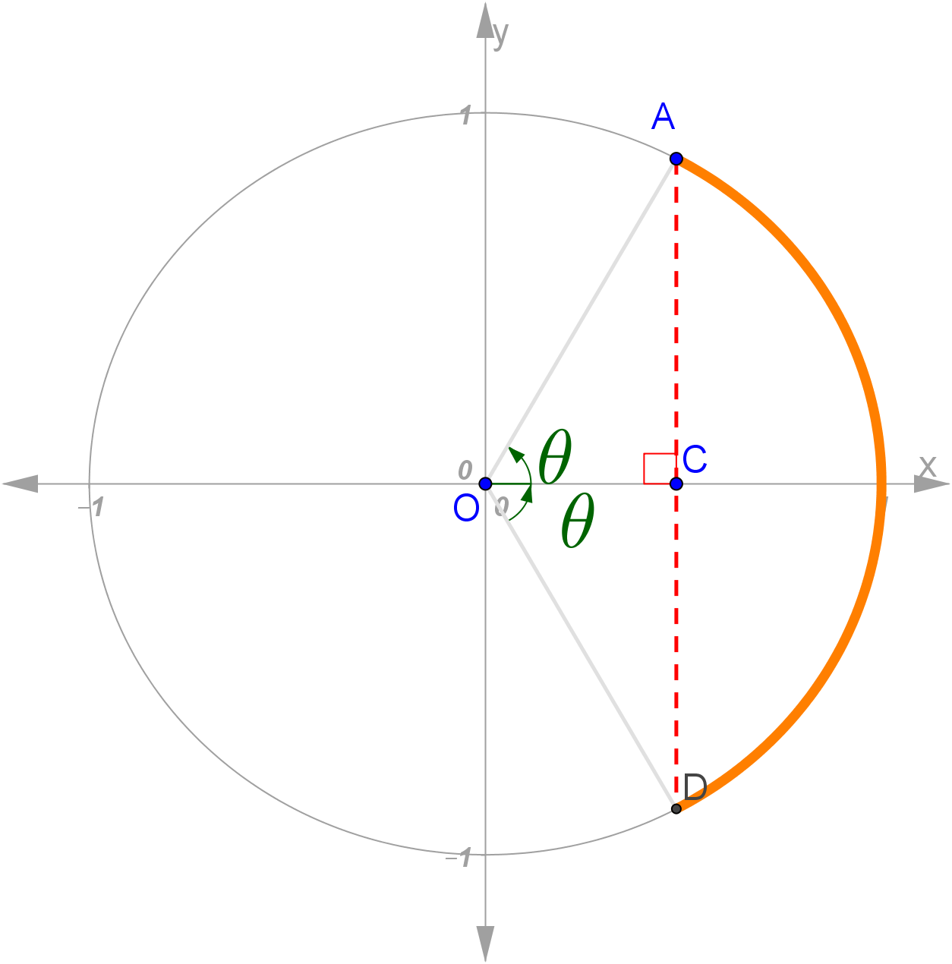
“Sine” strikes the right cord.
Sanskrit word “jiva”, meaning “bowstring”
Arabic translation “jayb” also meaning “bosom of a garment”
Latin translation “sinus”
English translation “sine”
https://www.macalester.edu/~bressoud/talks/2011/History0fTrig_NHCC.pdf
http://mathforum.org/library/drmath/view/52578.html

Slide 15
Why is the tangent function called “tangent”?
See the Geogebra app
called “tangent_function.ggb”

Slide 16
Why is the secant function called “secant”?
See the Geogebra app
called “secant_function.ggb”

Slide 17
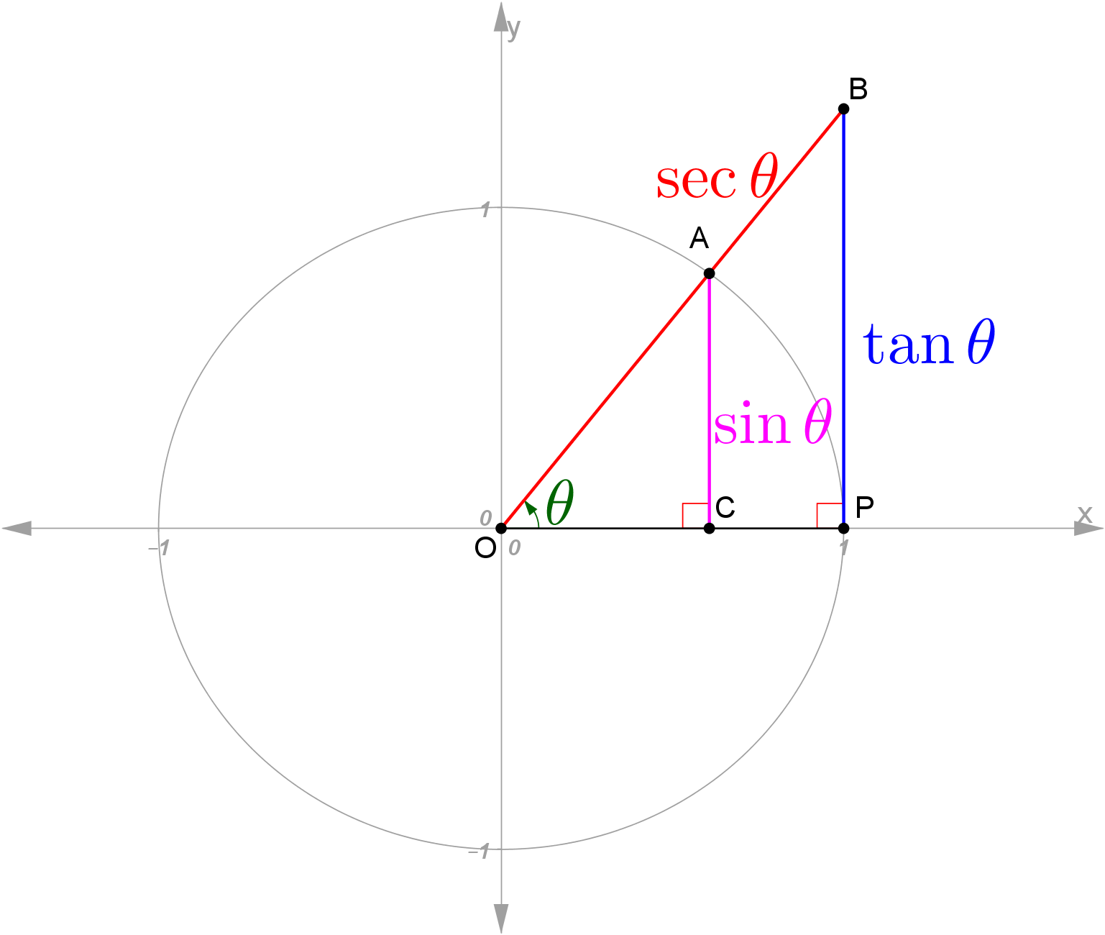
The whole shebang in one picture
Cosine, cotangent, and cosecant are the complementary functions.

Slide 18
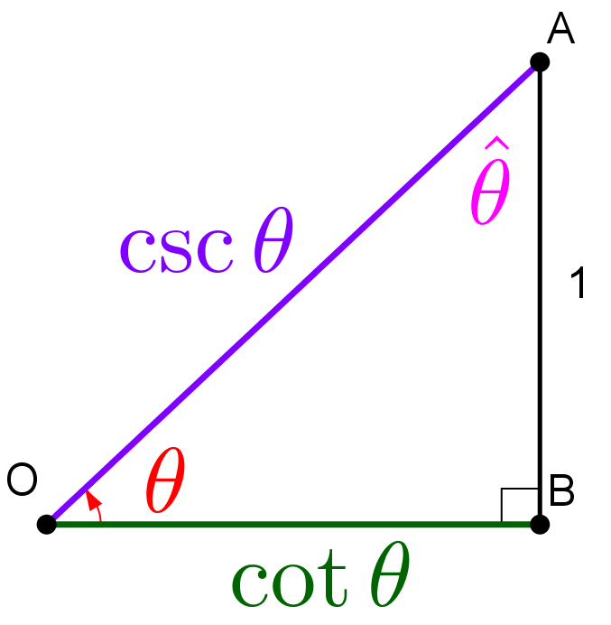
The Complementary Functions

Slide 19
APPENDICES

Slide 20
Set the two expansions of equal (e^{iθ})² equal
Replace 2θ with a:

Slide 21
Set the two expansions of equal (e^{iA}) (e^{iB}) equal
Replace B with –B, use even/odd properties:

